Slide 1
Prototype #1 Meeting
When & Where: March 18th, 2020 ~ 1:00pm - 2:00pm via Zoom
Meeting ID: 891 237 641
Attendees: Dr. Kristin Stewart, Dr. Shaunn-inn Wu, Stoic Solutions Team

Slide 2
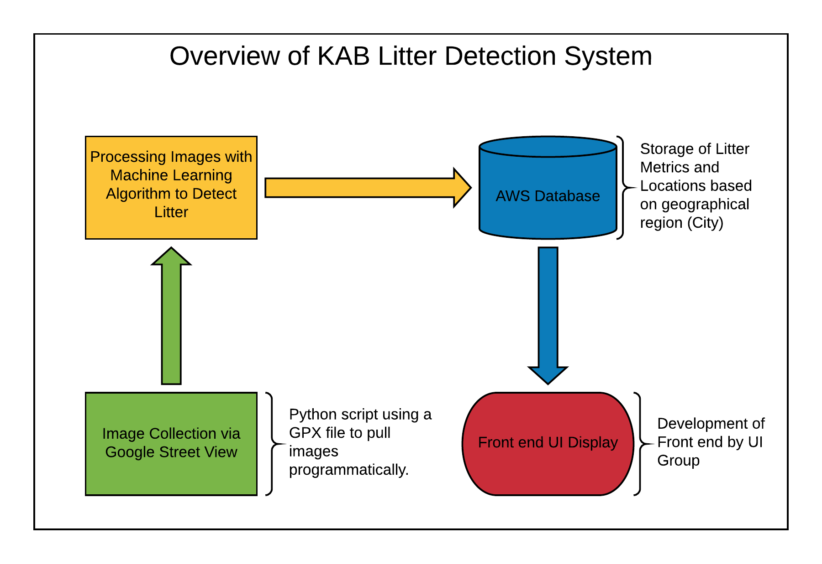
Current Requirements
Hosting the database
Mapped routes along San Marcos streets.
Using Google Street View API (Application Programming Interface) for panoramic images.
Saving images to disk for processing with the machine learning algorithm.
Processing images and receiving litter metrics for storage on AWS database.
Populating database with machine learning output.

Slide 3
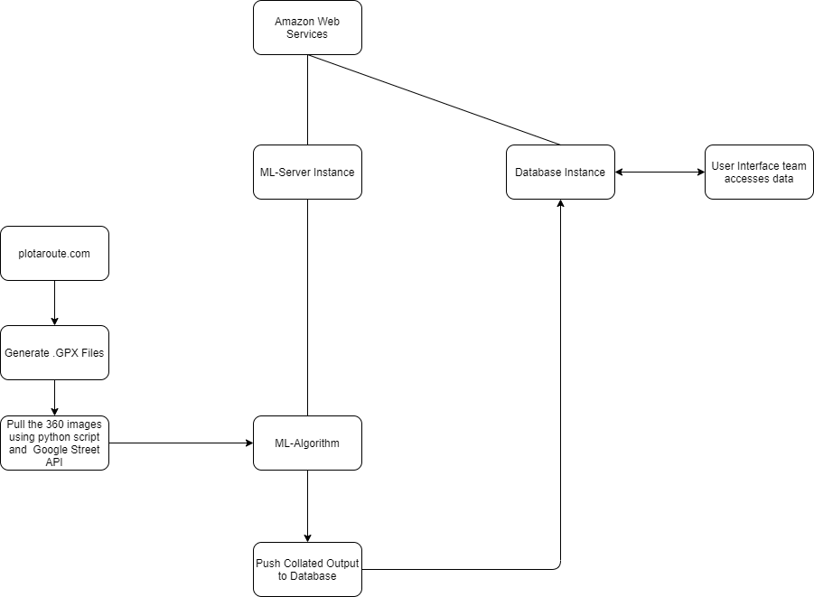
Closer View of the System

Slide 4
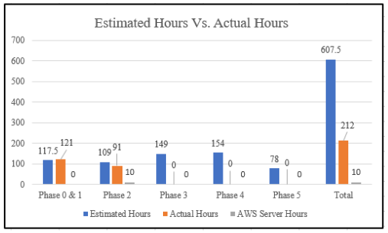
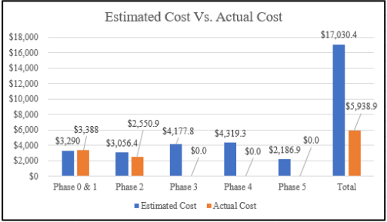
Project Management

Slide 5
List of deliverables
Create and populate the database on the AWS account. Database will be populated with latitude and longitude, corresponding litter metrics for the location and date pulled.
Pull google images from the agreed upon route and run them through the machine learning algorithm.
GPX Files for the routes ran by our scripts (for future use of historical data).

Slide 6
Analysis and Design
The UI team needs a reasonably high resolution of data, yet automated method of sampling points in San Marcos is not a simple task.
Stoic Solutions chose to map routes manually for a large portion of streets giving us a very high resolution of data points.
Pros: Cheaper (requires less calls to Google’s API which is expensive), higher resolution, control of possible duplicate routes.
Cons: Not as scalable due to high degree of manual route creation, time consuming, gaps in data from human error.

Slide 7
Analysis and Design (continued)
The forward and backward orientations from GSV images produce low rates of trash identification and would also be duplicated on subsequent images.
This was resolved by our team through the use of a Python script to calculate the current heading and capturing the images to the left and right along the specified path (capturing only the sides of the street).
See 360 Image Pulling (Next Slide)

Slide 8
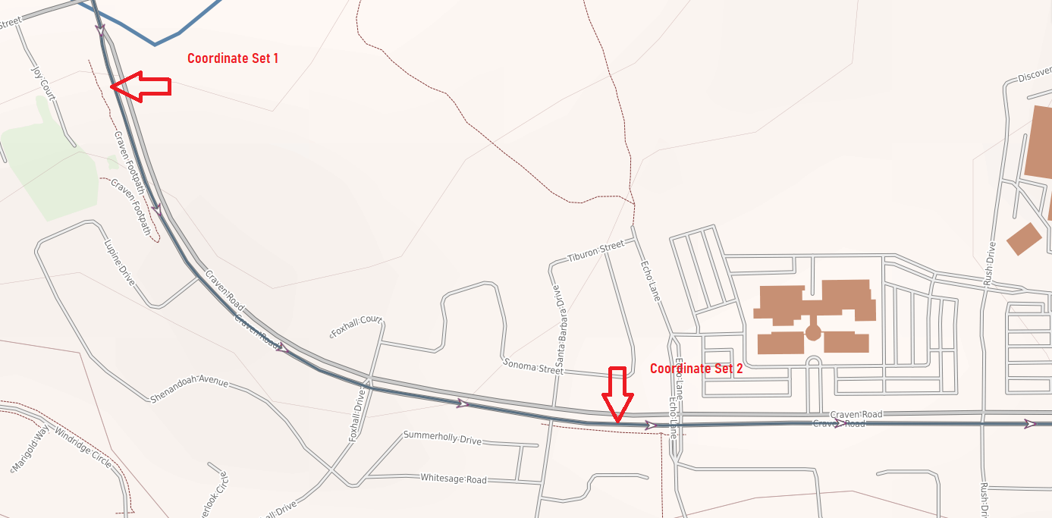
360 Image Pulling
As you will see in the image sets, our script has dynamically adjusted the heading of the images to look at the appropriate left and right side of the street (rather than pulling a random heading, which may not be directed towards the sidewalks).

Slide 9
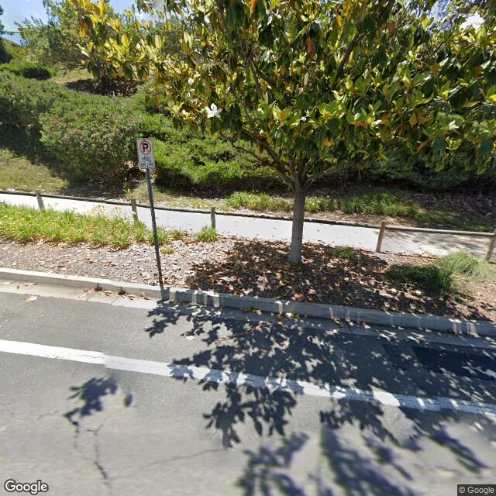
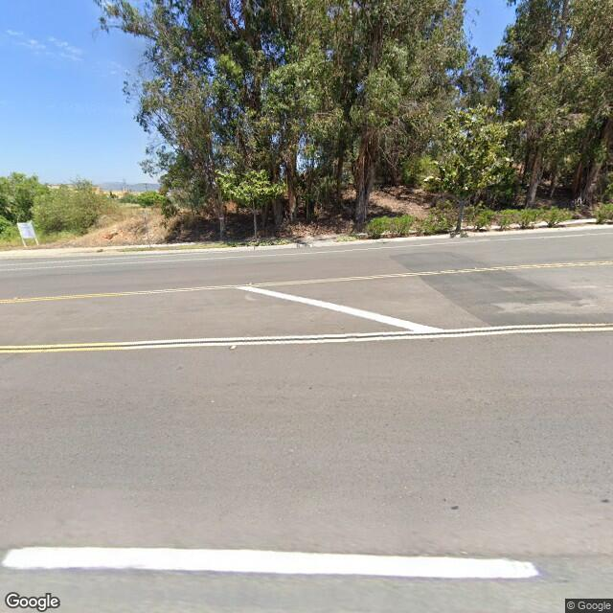
COORDINATE SET 1
Angle 1 ( 33.131572,-117.180281_A1.jpg ) Angle 2 ( 33.131572,-117.180281_A2.jpg )

Slide 10
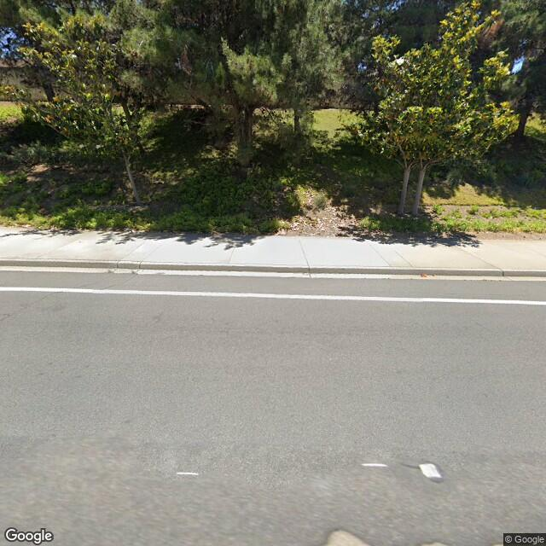
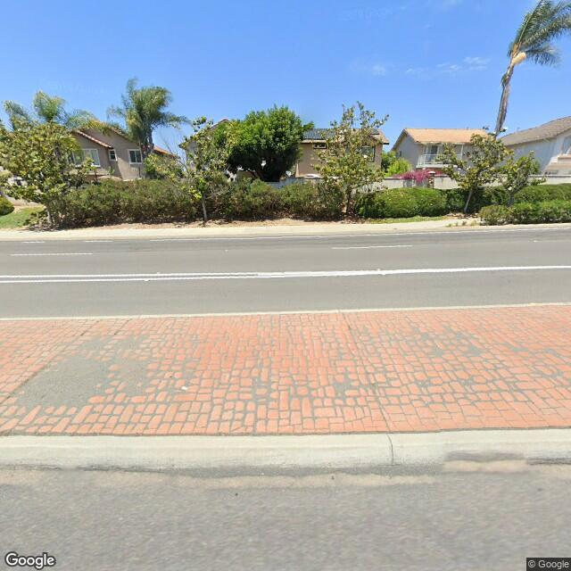
COORDINATE SET 2
Angle 1 ( 33.127333,-117.173499_A1.jpg ) Angle 2 ( 33.127333,-117.173499_A2.jpg )

Slide 11
Analysis and Design (continued)
Creating the Entity Relationship DIagram (ERD) for the database was very simple as all of the data we need will be in the same table.
The data that will be passed on to the UI team from the images will be the date taken, latitude, longitude, level of litter, and number of litter pieces.

Slide 12
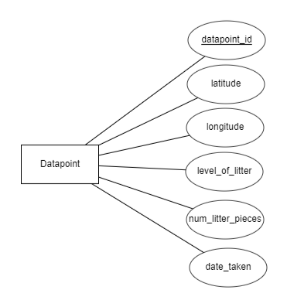
ERD (Entity Relationship Diagram)
Table(s):
Datapoint ( datapoint_id, latitude, longitude, level_of_litter, num_litter_pieces, date_taken )
CREATE TABLE SanMarcos (
datapoint_id INT AUTO_INCREMENT,
latitude FLOAT,
longitude FLOAT,
level_of_litter INT,
num_litter_pieces INT,
date_taken DATE
);

Slide 13
Final Thoughts and Goals
Elicit decisions from the customer.
UI team communication and goals.

Slide 14
Client feedback and questions

